Slide 1
PROJECT REPORT
CLOUD APPLICATION DEVELOPMENT
Under the guidance of
Prof. Harvinder Singh

Slide 2
PROJECT TITLE
CARBON FOOTPRINT EMISSION
Carbon footprint emission is a measure of the amount of greenhouse gases, mainly carbon dioxide, that is released into the atmosphere as a result of human activities.
These activities can range from daily actions such as transportation and energy consumption to large-scale industrial processes.
The carbon footprint of a product, service or individual is becoming an increasingly important consideration in today's society, as people become more aware of the impact that their actions have on the environment.
Understanding and reducing our carbon footprint is crucial in mitigating the effects of climate change and ensuring a sustainable future for our planet.

Slide 3
INTRODUCTION
The global warming issues now become a universal problem for all nations. The Intergovernmental Panel on Climate Change (IPCC) reported that scientists were more than 95% certain that most of global warming is caused by increasing concentrations of greenhouse gasses and other human (anthropogenic) activities. About eight billion tons per year of carbon in the form of CO2 emitted globally through burning fossil fuels for transport and for the production of heat and electricity around the world. Emission of carbon dioxide is the rest results of combustion of water (H2O) and carbon monoxide gas (CO) or also called as carbon dioxide (CO2) that is a greenhouse gas. There’s a concept as references in the measurement of CO2 emission, namely carbon footprint.
The idea is to predict the per capita CO2 footprints caused due to the heavy usage of transport in our country by using Machine Learning model.
Carbon footprint has become a widely used term and concept in the public debate on responsibility and abatement action against the threat of global climate change.
The following point highlights the model in detail:
Firstly cleaned the dataset and performed Categorical Encoding on Categorical Features and Feature Scaling on Numerical Features.
After that, performed Train_Test_Split Cross-Validation and tried different Regression Algorithms ( Multi-Variable Linear Regression, Support Vector Regression, Decision Tree Regression & Random Forest Regression ).
Finally, opted for Random Forest Regression for the model for its stable predictions through which I led the model to an accuracy of 99.6%.

Slide 4
FUNCTIONAL REQUIREMENTS
Functional requirements for a carbon footprint emission project could include:
Data Collection: The system should be able to collect data related to energy consumption, transportation, waste generation, and other factors that contribute to carbon emissions.
Calculation and Analysis: The system should be able to use the collected data to calculate the carbon footprint of an individual or an organization. It should be able to provide insights and recommendations for reducing carbon emissions.
Reporting: The system should be able to generate reports that show the carbon footprint of an individual or an organization. The reports should be customizable, allowing the user to select the time period and scope of the report.
User Management: The system should have a user management system that allows for different levels of access to the system, depending on the user’s role.
Integration: The system should be able to integrate with other systems such as energy management systems, transportation management systems, and waste management systems to get data that can be used to calculate the carbon footprint.

Slide 5
NON-FUNCTIONAL REQUIREMENTS
Non-functional requirements are the quality attributes that define the characteristics of the system and specify how it should behave. These requirements usually focus on aspects such as performance, reliability, security, usability, and maintainability. For the project on carbon footprint emission, some non-functional requirements could include:
Performance: The system should be able to handle a large number of users and data without experiencing any lag or downtime.
Security: The system should ensure the confidentiality, integrity, and availability of the data collected and stored.
Usability: The system should be easy to use and navigate for all types of users, including those who are not tech-savvy.
Accessibility: The system should be accessible to users with disabilities, including those who are visually or hearing impaired.
Scalability: The system should be designed to handle increasing data volumes and users in the future.
Maintainability: The system should be easy to maintain and update, with minimal downtime or disruption to users.
Sustainability: The system should be designed and operated in an environmentally sustainable manner, with minimal carbon footprint and impact on the environment.

Slide 6
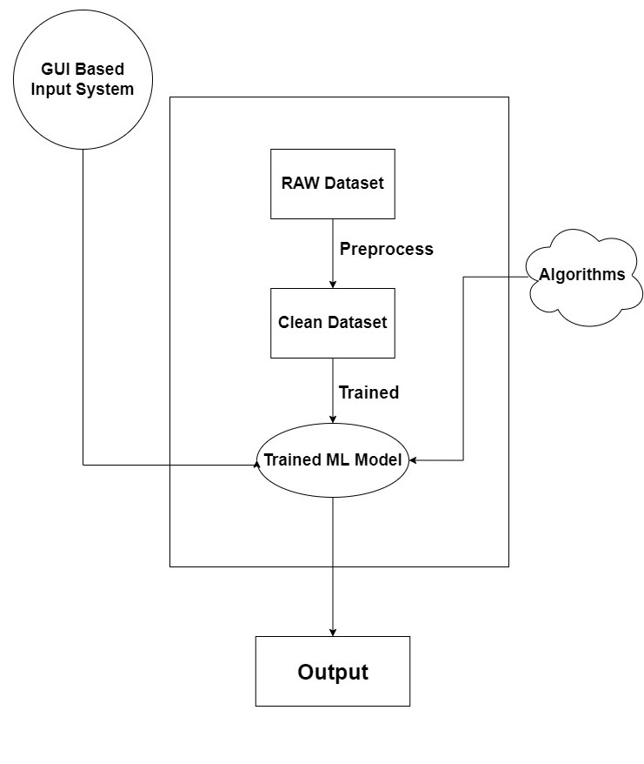
SYSTEM DESIGN-FLOW CHART

Slide 7
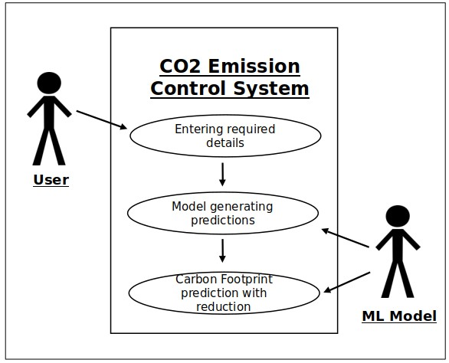
USE CASE DIAGRAM

Slide 8
TEST CASES
Here are some example use cases for a system that tracks and reports carbon footprint emissions:
User calculates personal carbon footprint: A user logs into the system and inputs data such as their mode of transportation, energy usage, and diet. The system calculates the user’s carbon footprint and provides suggestions for reducing emissions.
Company tracks emissions data: A company uses the system to track its carbon footprint and emissions data. The system can provide reports and analytics to help the company identify areas for improvement and track progress towards emission reduction goals.
Government monitors emissions data: A government agency uses the system to monitor carbon emissions data across multiple companies and industries. The system can provide analytics and alerts for areas of concern, and help the government enforce emissions regulations.
Carbon offsetting and trading: The system can also integrate with carbon offsetting and trading platforms, allowing users and companies to offset their emissions by investing in carbon reduction projects or purchasing carbon credits. The system can provide recommendations for offsetting options and track carbon credit transactions.

Slide 9
ACCEPTANCE CRITERIA
Acceptance criteria are specific and measurable criteria that must be met in order for the project to be considered successful. Here are some possible acceptance criteria for a carbon footprint emission project:
The system must accurately calculate carbon emissions based on user inputs.
The system must be easy to use, with a user-friendly interface.
The system must be accessible from a variety of devices, including desktop computers, laptops, tablets, and smartphones.
The system must be secure, with appropriate safeguards in place to protect user data.
The system must provide users with a clear and detailed breakdown of their carbon footprint, including recommendations for reducing their emissions.
The system must be scalable, able to handle a large number of users and data inputs without slowing down or crashing.
The system must comply with all relevant laws and regulations regarding carbon emissions and data privacy.
The system must be tested thoroughly to ensure accuracy, reliability, and usability.
The system must be delivered on time and within budget.
The system must receive positive feedback from users, indicating that it is meeting their needs and expectations.

Slide 10
REFERENCES
IPCC 2014 Climate Change 2014 Synthesis Report: Headline statements from the Summary for Policymakers
IPCC 2007 Synthesis Report. Contribution of Working Groups I, II and III to the Fourth Assessment Report of the Intergovernmental Panel on Climate Change
Dayaratne S P and Gunawardana K D 2014 Carbon footprint reduction: a critical study of rubber production in small and medium scale enterprises in Sri Lanka J. Clean. Prod.
Wiedmann T, Minx J, Barrett J and Wackernagel M 2006 Allocating ecological footprints to final consumption categories with input--output analysis Ecol. Econ. 56 28– 48
Wiedmann T and Minx J 2007 A Definition of ‘ Carbon Footprint Science (80-. ). 1 1–11
Andrić I, Jamali-Zghal N, Santarelli M, Lacarrière B and Le Corre O 2015
Environmental performance assessment of retrofitting existing coal fired power plants to co-firing with biomass: carbon footprint and emergy approach J. Clean. Prod. 103 13– 27
Grubb T and Ellis C 2007 Meeting the carbon challenge: The role of commercial real estate owners Users Manag. Chicago
Jones C M and Kammen D M 2011 Quantifying carbon footprint reduction opportunities for US households and communities Environ. Sci. Technol. 45 4088–95

